Slide 1
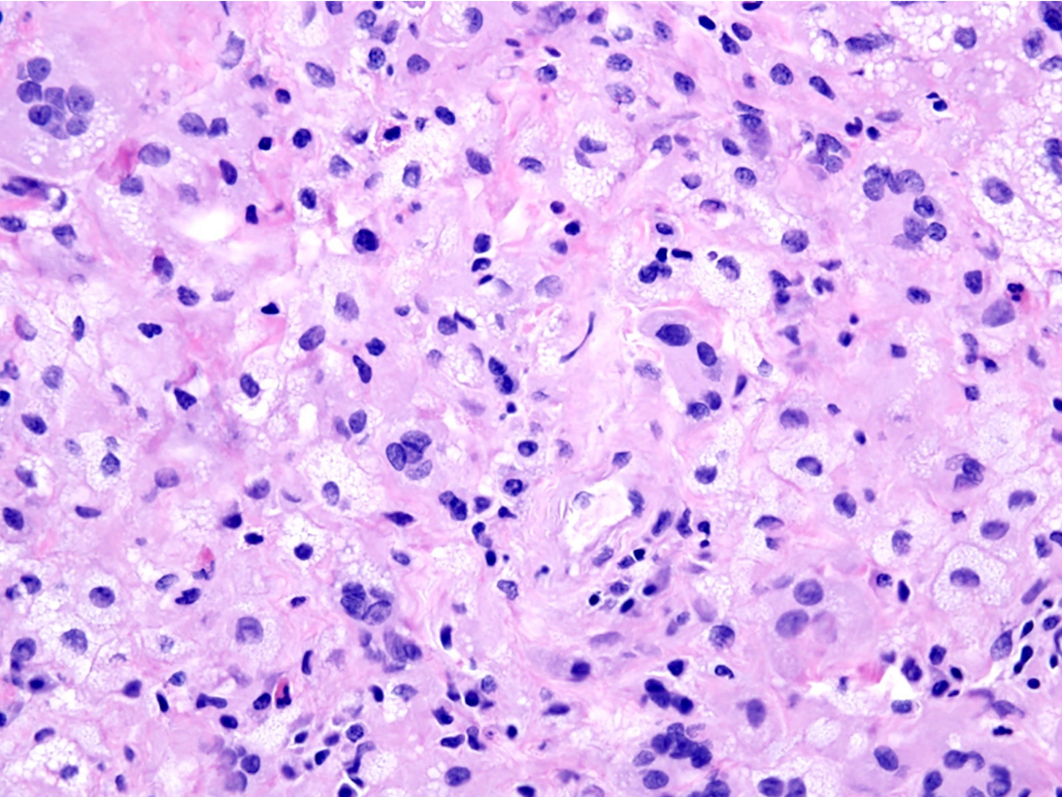
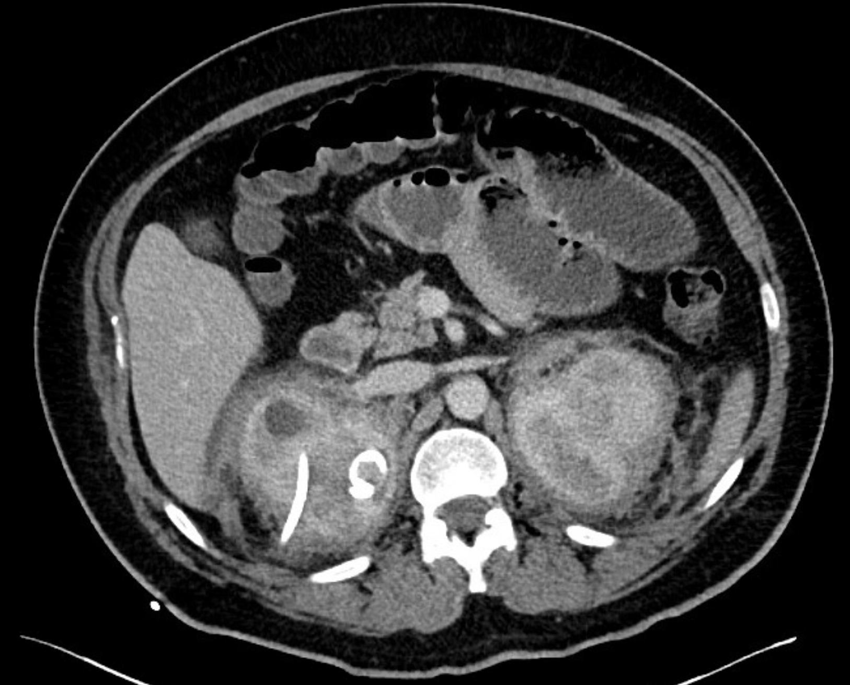
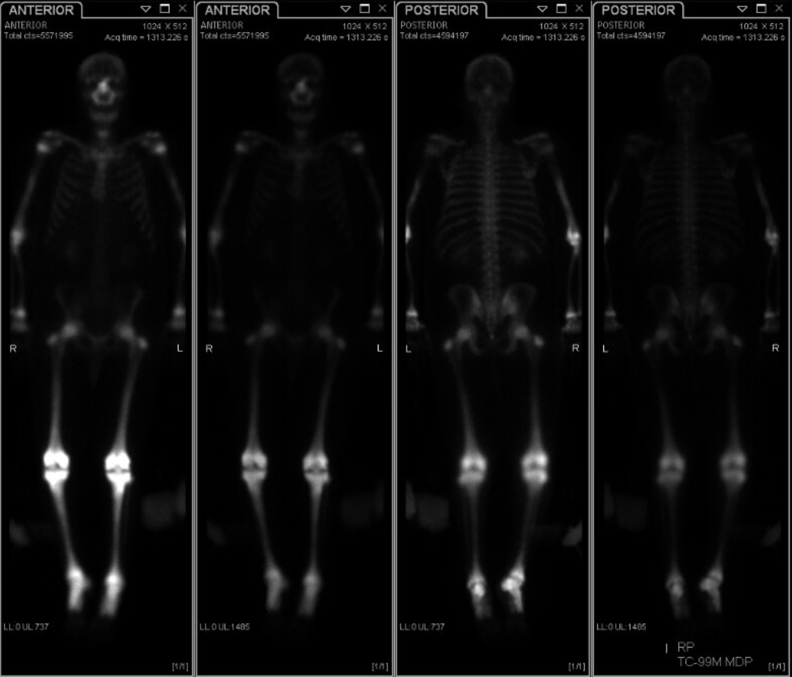
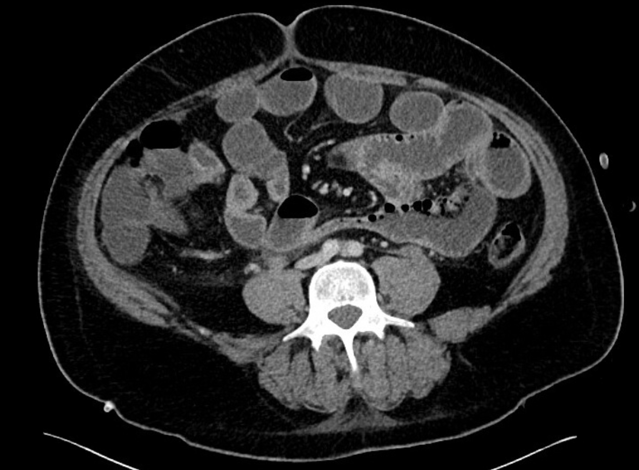

A case of Erdheim-Chester Disease (ECD) with gastrointestinal involvement
Phillip Anjum¹, Reed Geisler¹, ²Kaitlin Kavanaugh, MD
¹The Ohio State University College of Medicine, Columbus, Ohio, ²Department of Surgery, The Ohio State University Wexner Medical Center, Columbus, Ohio
Background
Case: 35 y.o. M with abdominal pain
The patient was initially managed conservatively for small bowel obstruction with a nasogastric tube and bowel rest.
By the fourth day of hospital stay, the patient still reported minimal flatus.
He received a dose of prednisone and was taken to the OR that day for diagnostic laparoscopy, during which he was found to have no small bowel obstruction or adhesions. An inflamed jejunum and ileum were noted.
Post-operative course was uncomplicated; he was discharged the following day.
Erdheim-Chester disease (ECD): a rare form of non-Langerhans cell histiocytosis derived from a monocyte-macrophage lineage.
Pathophysiology: Somatic mutations of BRAF or other components of the MAPK signaling pathway are present in more than 50% of patients with ECD ¹. Pathology shows histiocytic infiltration with sheets of foamy histiocytes on biopsy (Figure 1).
Presentation: ECD is a multisystem disease that can encompass a wide spectrum of disorders.
Skeletal involvement, the most common clinical manifestation, occurs in the form of multifocal sclerotic lesions in the long bones of lower limbs (Figure 2).
Other common clinical features include diabetes insipidus, neurologic symptoms, constitutional symptoms, circumferential thickening of the aorta, and retroperitoneal fibrosis ².
PMH: retinitis pigmentosa, hypertension, diabetes insipidus, bilateral ureteral obstruction status post bilateral nephrostomy tubes, avascular necrosis of the left hip. ECD diagnosed 1 month prior to presentation.
HPI: 4-day history of nausea, vomiting, diarrhea, and abdominal pain. He denied flatus for several days.
PE: abdomen was soft, distended, and had mild tenderness to palpation. Patient was hypertensive to 152/91. Otherwise unremarkable.
Imaging: CT findings suggestive of small bowel obstruction and acute enteritis (Figures 3 & 4)
Figure 1: Soft tissue sample showing foamy (xanthomatous) histiocytes with surrounding fibrosis
Conclusion
This case illustrates a classic presentation of ECD: an adult male with long bone involvement (avascular necrosis of the left hip) and diabetes insipidus.
Unique to this case was jejunal and ileal involvement with associated small bowel obstruction.
Prednisone is recommended for management of ECD, but the patient might have also benefited from INFa, which is the first-line treatment for ECD². Furthermore, steroid treatment may be contraindicated in ECD patients with GI involvement ³.
While ECD can present in a variety of multisystemic manifestations, the most common presenting symptom is bone pain, especially of the lower limb ⁵.
Figure 3: numerous dilated loops of proximal small bowel with air fluid levels
Figure 2: Bone scan showing diffuse increased uptake within osseous structures and periarticular surfaces
References
Figure 4: Enhancing wall thickening of the ileum
1. Cives M, Simone V, Rizzo FM, et al. Erdheim-Chester disease: A systematic review. Crit Rev Oncol Hematol. Published online 2015. doi:10.1016/j.critrevonc.2015.02.004
2. Campochiaro C, Tomelleri A, Cavalli G, Berti A, Dagna L. Erdheim-Chester disease. Eur J Intern Med. Published online 2015. doi:10.1016/j.ejim.2015.03.004
3. Christophi GP, Sharma Y, Farhan Q, et al. Erdheim-chester disease presenting with histiocytic colitis and cytokine storm. J Gastrointest Liver Dis. Published online 2017. doi:10.15403/jgld.2014.1121.262.erd
4. Tevlin R, Cahalane AM, Larkin JO, Treacy A, Connaghan D, Winter DC. Gastrointestinal Erdheim-Chester disease. Ir Med J. Published online 2014.
5. Veyssier-Belot C, Cacoub P, Caparros-Lefebvre D, et al. Erdheim-Chester disease: Clinical and radiologic characteristics of 59 cases. Medicine (Baltimore). Published online 1996. doi:10.1097/00005792-199605000-00005
Notes:
Rare, clonal histiocytosis with frequent multiorgan involvement (Histiocytosis is a generic name for a group of syndromes characterized by an abnormal increase in the number of certain immune cells called histiocytes. These include monocytes, macrophages, and dendritic cells)
First described in 1930 by William Chester and Jakob Erdheim
Previously thought to be an inflammatory disorder, recognized as a neoplasm in WHO Classification of Tumours of Haematopoietic and Lymphoid Tissues in 2016
Background
Erdheim-Chester disease (ECD) is a rare form of non-Langerhans cell histiocytosis derived from a monocyte-macrophage lineage. Somatic mutations of BRAF or other components of the MAPK signaling pathway are present in more than 50% of patients with ECD ¹. This multisystem disease presents as histiocytic infiltration with sheets of foamy histiocytes on biopsy, and it can encompass a wide spectrum of disorders.
Skeletal involvement, the most common clinical manifestation, occurs in the form of multifocal sclerotic lesions in the long bones of lower limbs. Other common clinical features include diabetes insipidus, neurologic symptoms, constitutional symptoms, circumferential thickening of the aorta, and retroperitoneal fibrosis ².
Case
A 35 y.o. male with a history of retinitis pigmentosa, hypertension, diabetes insipidus, bilateral ureteral obstruction status post bilateral nephrostomy tubes, avascular necrosis of the left hip, and ECD presented with a 4-day history of nausea, vomiting, diarrhea, and abdominal pain. He reported not being able to keep anything down and having a decreased appetite. His last bout of emesis occurred the morning of presentation, while his last bowel movement occurred the morning before presentation. He denied flatus for several days.
The patient had initially presented 1 month prior for idiopathic bilateral ureteral obstruction. During that hospital stay, a bone scan showed diffuse uptake within osseous structures, and a PET scan revealed bilateral tonsillar uptake and diffuse hypermetabolic activity within bilateral adrenal glands with soft tissue thickening. Diagnosis of ECD was confirmed with a mandible and maxillary biopsy that revealed chronic xanthogranulomatous and lymphocytic inflammation consistent with the disease.
On exam, the patient’s abdomen was soft, distended, and had mild tenderness to palpation. The physical exam was otherwise unremarkable. He was hypertensive to 152/91, but otherwise his vitals and labs were within normal limits. A CT showed dilated loops of jejunum and proximal ileum, with a focal distal transition point of small bowel dilation at an ileal loop in the patient’s right lower quadrant, consistent with small bowel obstruction, as well as mild wall and fold thickening of the jejunum and ileum, suggestive of acute enteritis.
The patient was initially managed conservatively for small bowel obstruction with a nasogastric tube and bowel rest. By the fourth day of hospital stay, the patient still reported minimal flatus. He received a dose of prednisone and was taken to the OR that day for diagnostic laparoscopy, during which he was found to have no small bowel obstruction or adhesions. An inflamed jejunum and ileum were noted. His post-operative course was uncomplicated, and he was discharged the following day.
Conclusion
This case illustrates a classic presentation of ECD: an adult male with long bone involvement (avascular necrosis of the left hip) and diabetes insipidus. Unique to this case was jejunal and ileal involvement with associated small bowel obstruction. Prednisone is recommended for management of ECD, but the patient might have also benefited from INFa, which is the first-line treatment for ECD². Furthermore, steroid treatment may be contraindicated in ECD patients with GI involvement ³. While ECD can present in a variety of multisystemic manifestations, the most common presenting symptom is bone pain, especially of the lower limb ⁵.

